Slide 1
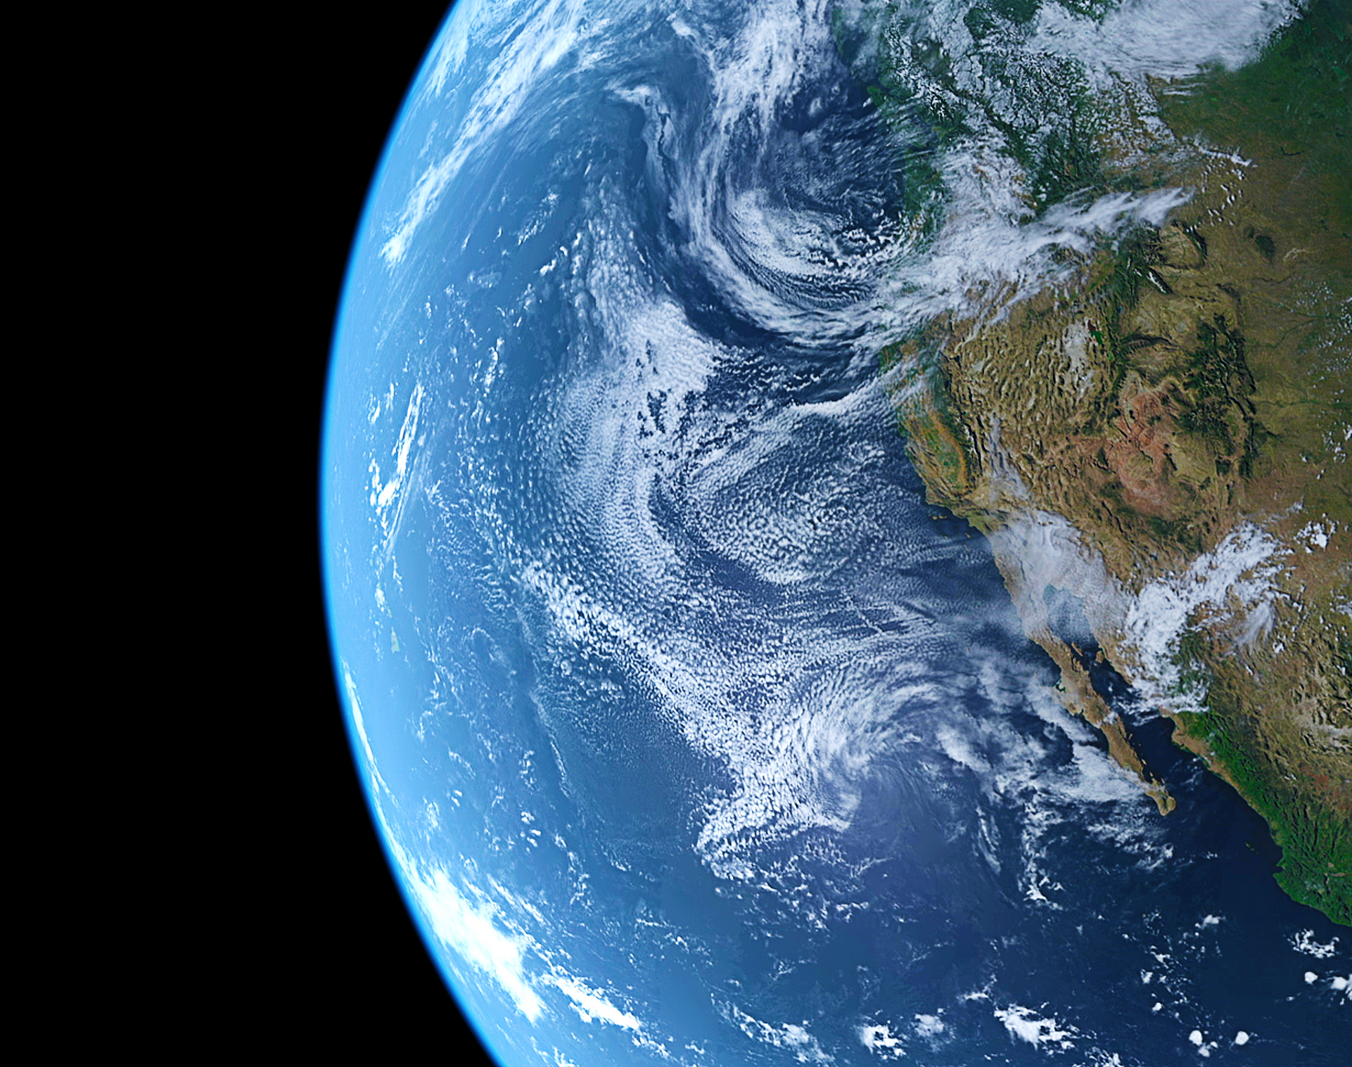
COVID-19 Group Presentation
Soona Brittney Cheon
Robert Freed
Jodi-Ann Osborne
Scott Rabinowitz
Notes:
Reason the topic is selected
Description of the source of data
Questions the team hopes to answer with the data
Description of the data exploration phase of the project
Description of the analysis phase of the project

Slide 2

Agenda
Definition: Human Development Index (High >=.7)
Regression Analysis
Analyze HDI impact on Vaccination Rollout
Analyze HDI and the number of new COVID 19 cases
Machine Learning Model
COVID-19 impact
Conclusion
Notes:
Today, we will cover the following items throughout out presentation. First, we will define Human development index as a measure of development that assess and weigh factors such as health, longevity, level of education, and the standard of living for residents of that country. This measure ranges from 0 to 1 with most developed countries being close to 1. For our presentation, we will identify high Human development Index as greater than or equal to .7. Next, we will provide insight into our data using linear regression and correlation matrix to access factors such as HDI, vaccination rollout, the number of new cases, new deaths, total cases, and total new deaths. Next, we will present our finding using a machine learning model to access the relationship between school closure status and country. We will provide numerous visualizations showing COVID-19 impact on select countries and provide a closing summary. Our datset contains data from December 13, 2020 to February 24, 2021.

Slide 6
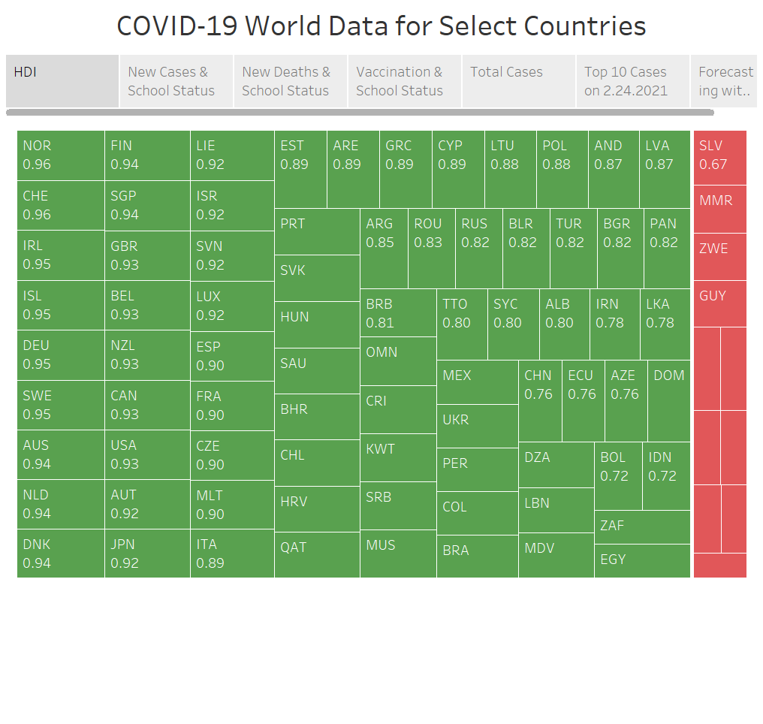
Notes:
The above illustration shows ISO codes and HDIs for the select countries. Countries in green have an HDI greater than to equal .7 while countries in red have an HDI less than .69.

Slide 7

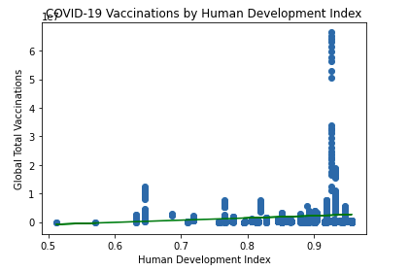
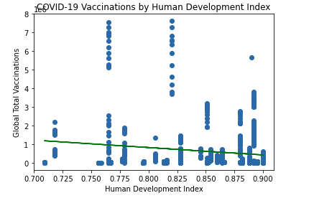
Analysis of Human Development Index and COVID-19 Vaccination Roll Out Thus Far

Slide 8
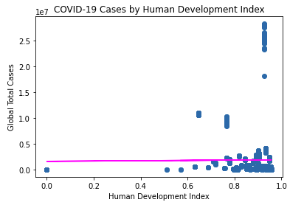
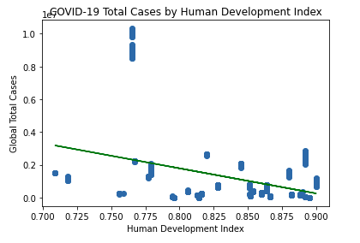
Analysis of Human Development Index and COVID-19 Cases Thus Far

Slide 9
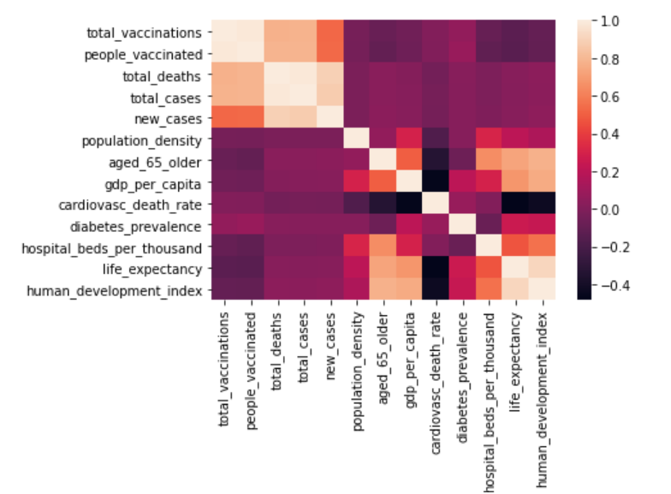
Correlation Matrix

Slide 10

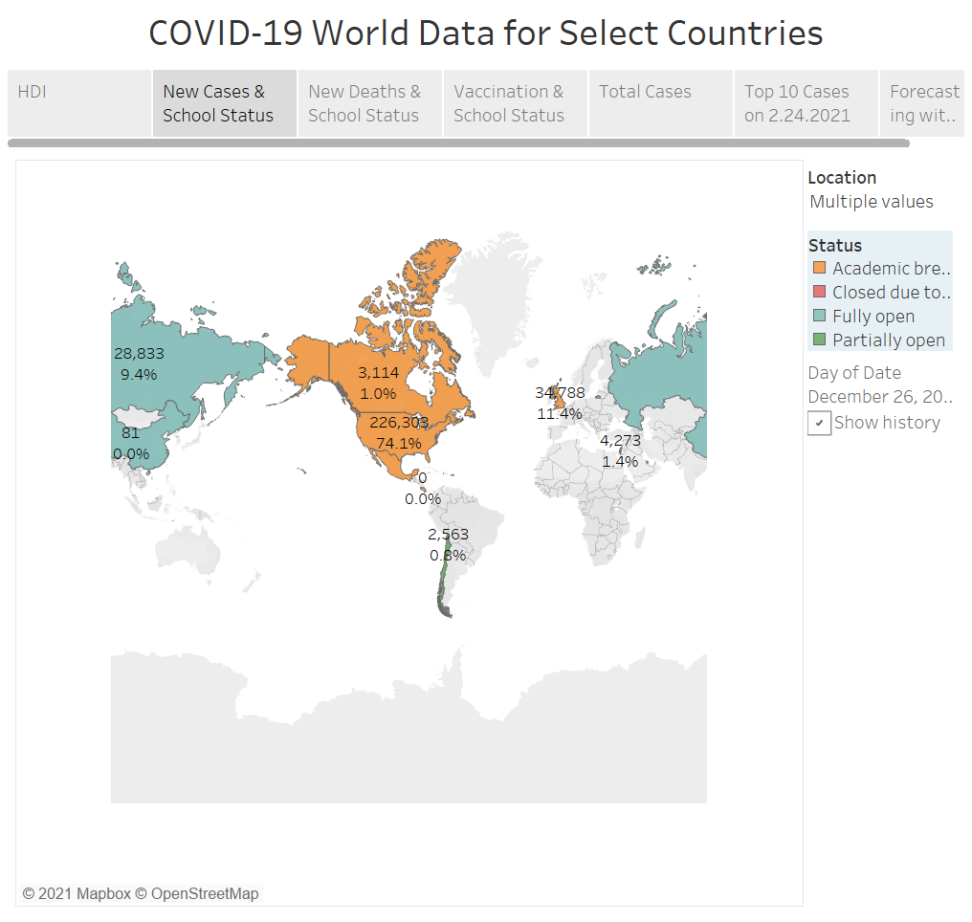

Slide 11
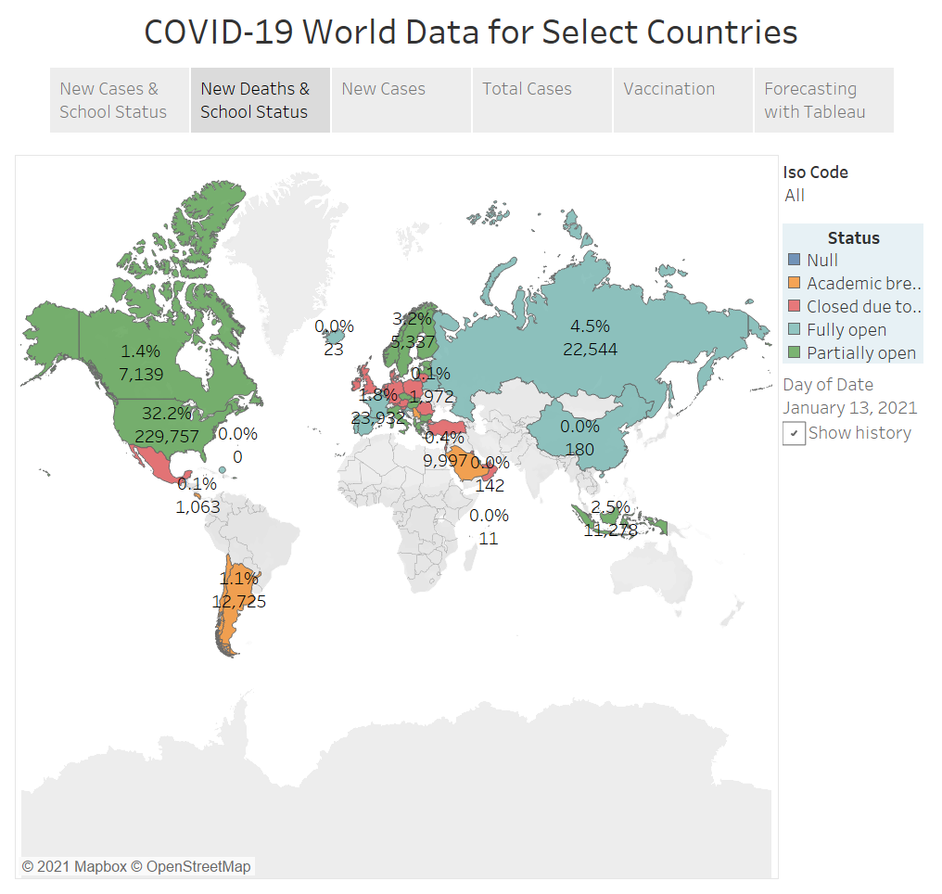
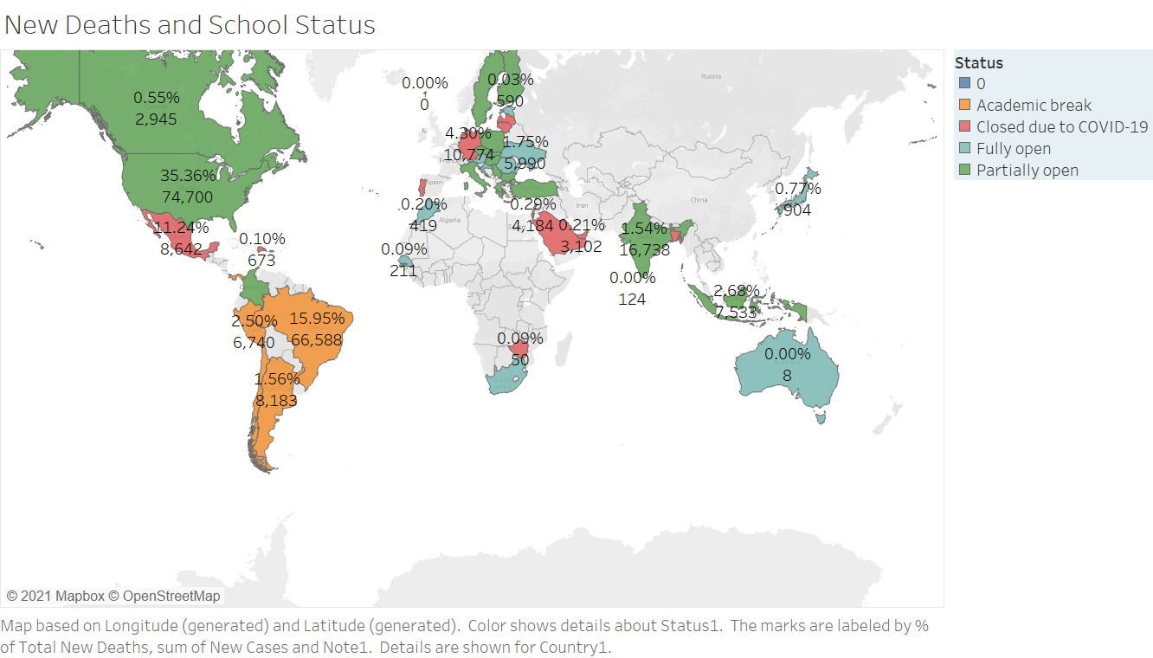

Slide 12
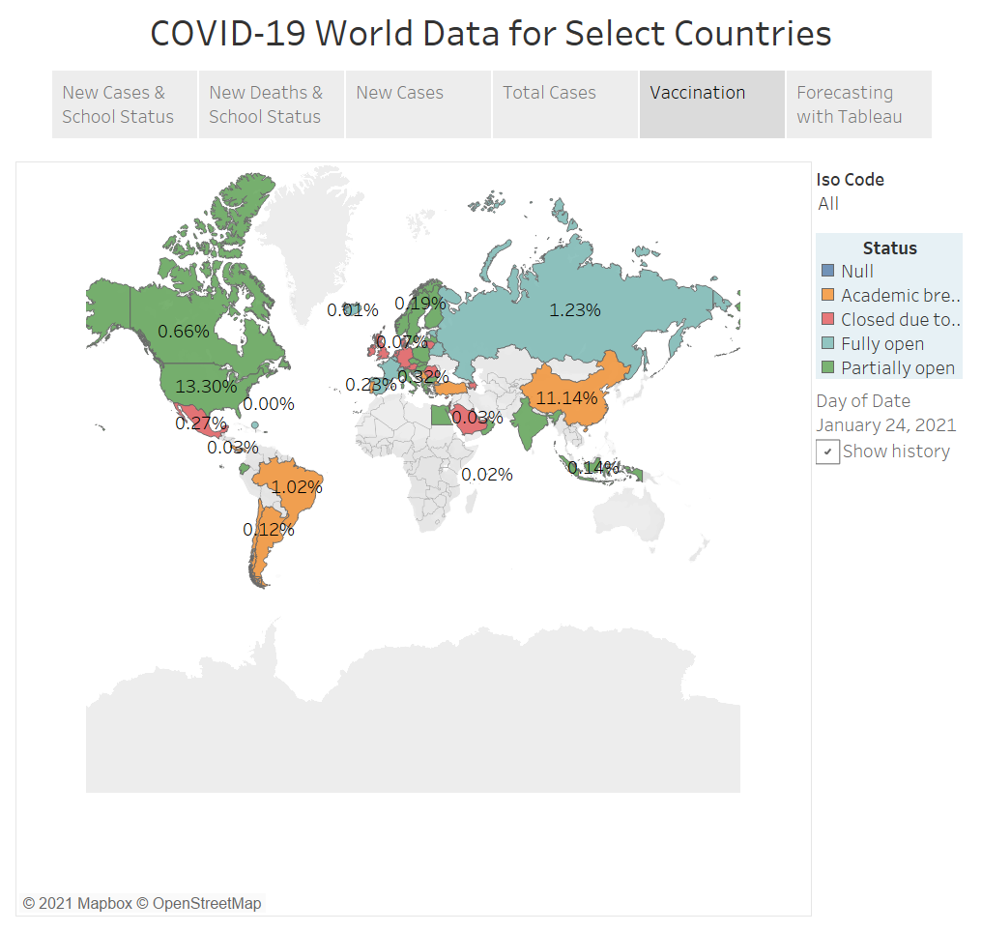
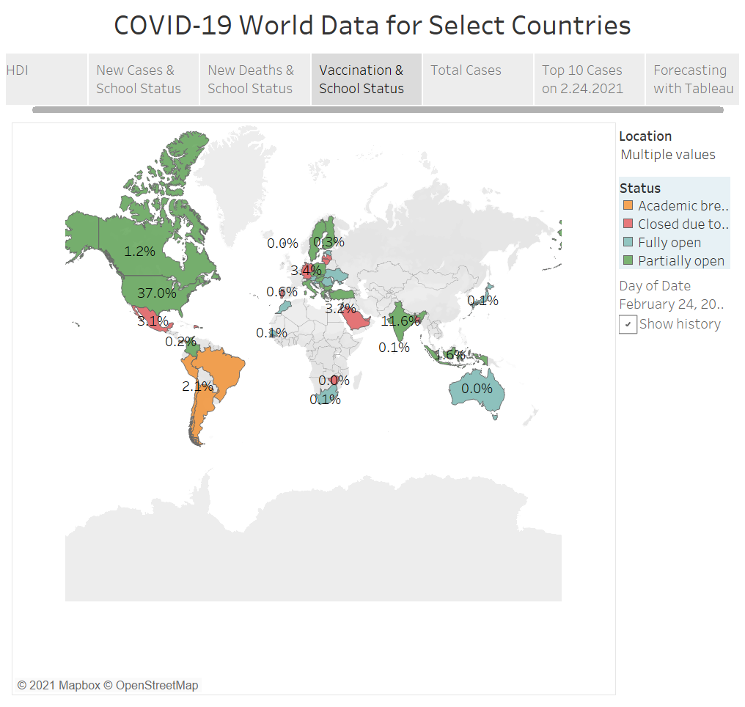

Slide 13
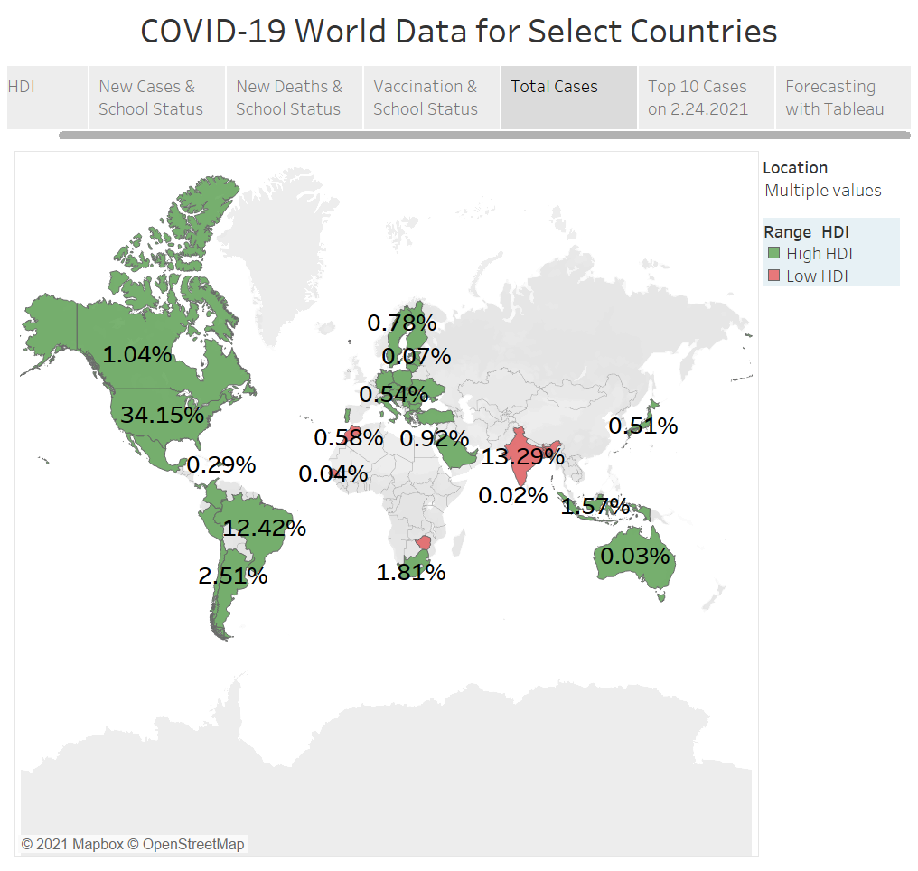

Slide 14
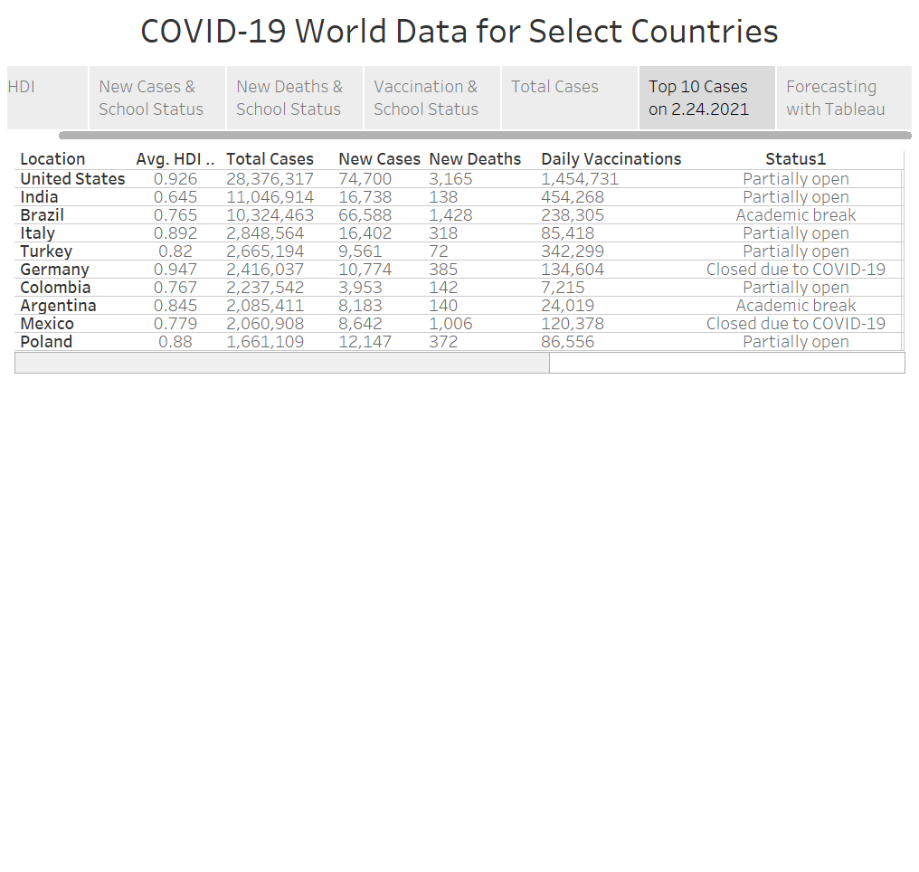

Slide 15
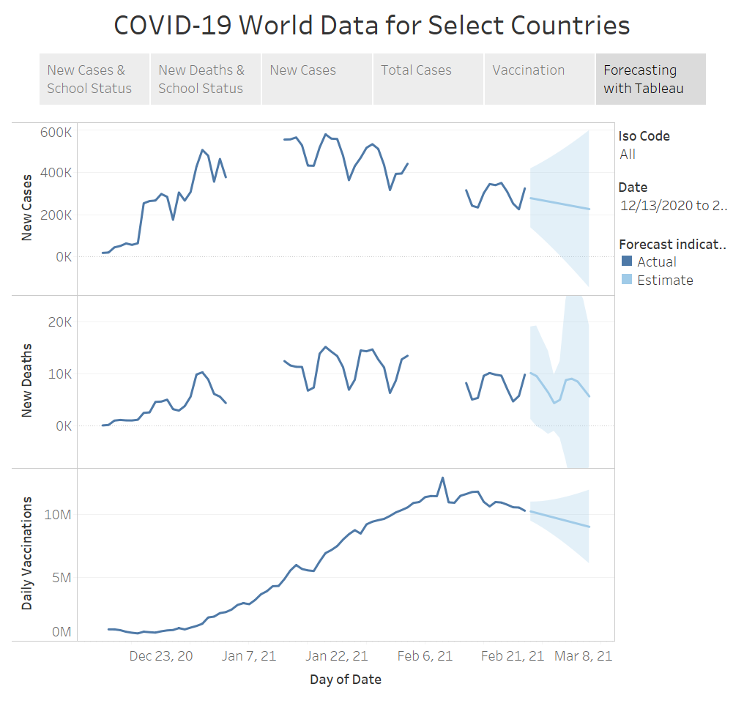

Slide 16
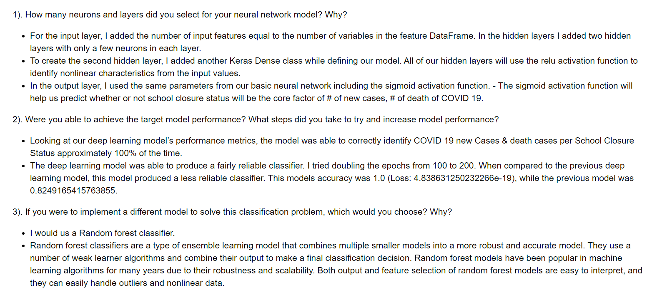
Machine Learning Summary

Slide 17
Driving Forces Behind Curbing COVID-19
HDI
Politics
Strains
Travel Restrictions
Availability of Testing and Vaccination

Slide 18

Questions???

